Slide 1
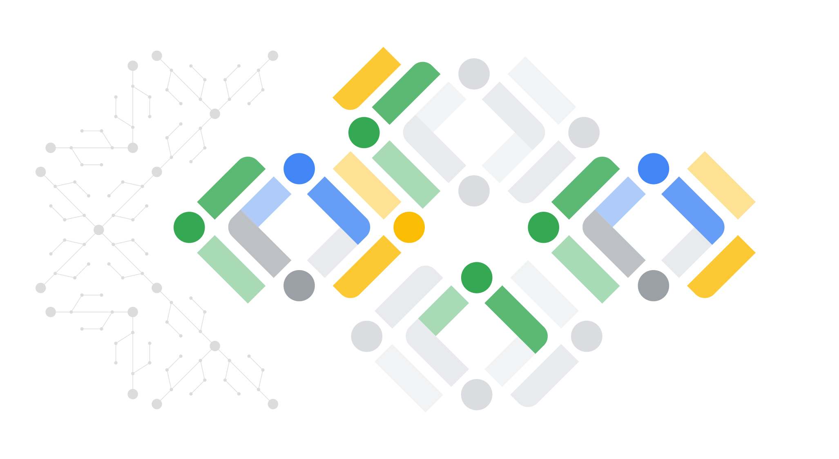

Introduction to Generative AI

Slide 2
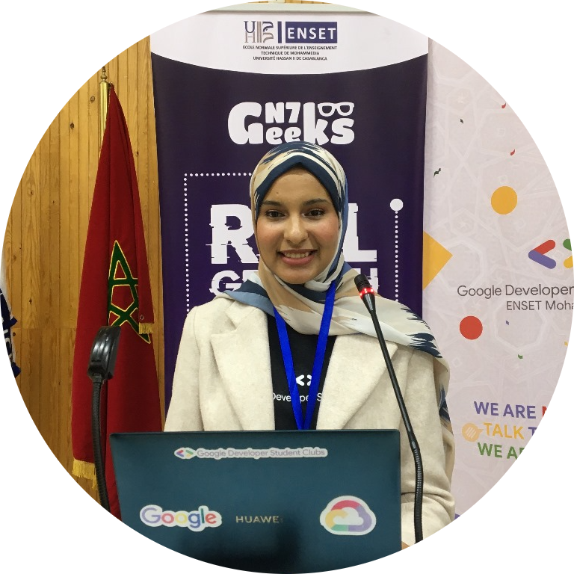
Khaoula ALLAK
GDG Mentor
Notes:
intro / socials slide

Slide 3
Table of Contents
01
What is Generative AI ?
02
Fundamentals of Large Language Models
03
How to customize the LLM ?
04
Practice

Slide 4
01
What is Generative AI ?
Notes:
Generative AI refers to systems that can create content, and LLMs (Large Language Models) are a type of generative AI specifically designed to generate human-like text based on learned patterns from vast amounts of data.

Slide 5
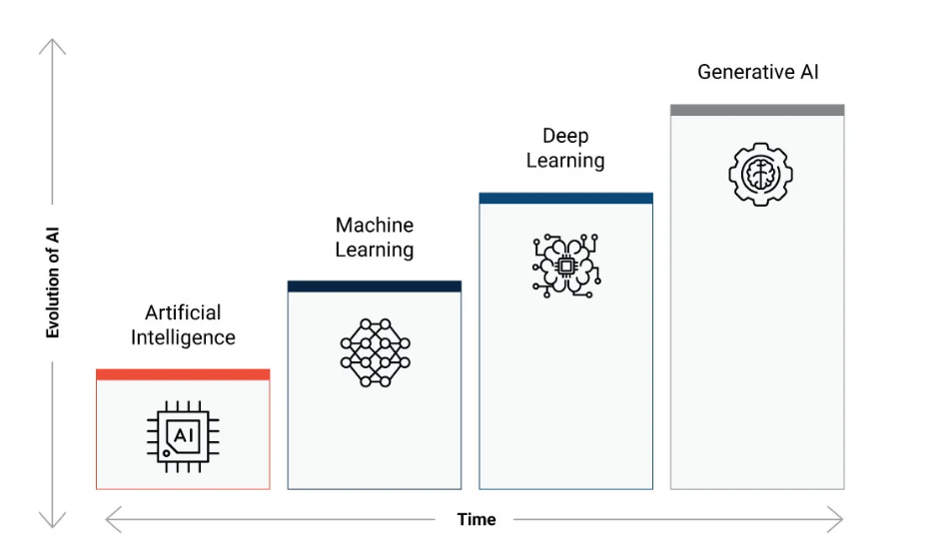
Evolution of AI
What matters
to us today !
Notes:
Ai is a discipline .Meanwhile ML is a subfield of AI .It trains the model from input data to make predictions
Generative AI produces type of content including text ,imagery ,audio.

Slide 6
Evolution of AI Use Cases
Predictive AI
Generative AI
Multimodal
Generative AI
Regression & Classification
Forecasting
Sentiment Analysis
Entity Extraction
Object Detection
Text, Image & Code Generation
Text & Code Rewriting & Formatting
Summarization
Extractive Q&A
Image & Video Descriptions
Natural Image Understanding
Spatial Reasoning and Logic
Mathematical Reasoning in Visual Contexts
Video Question Answering
Automatic Speech Recognition & Translation

Slide 7
02
Fundamental of LLMs
Notes:
A language model is a probabilistic model of text.
LLM ,large refers to number of parameters.

Slide 8
What is LLM?
Large Language Model
An LLM is a computer program that has been fed enough examples to able to recognize and interpret human language or other types of complex data.
LLM are very large models that are pre-trained on vast amounts of data.
It can perform different tasks such as answering questions, summarizing documents, translating languages and completing sentences.

Slide 9
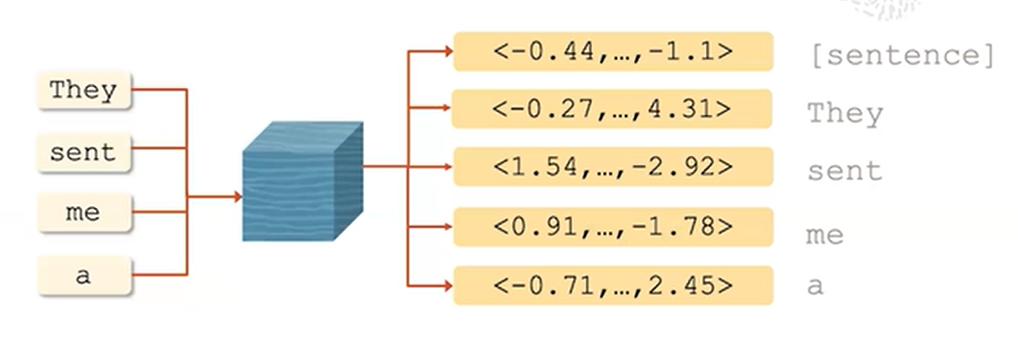
LLM Architecture
Encoder
Models that convert a sequence of words to an embedding(Vector representation)

Slide 10
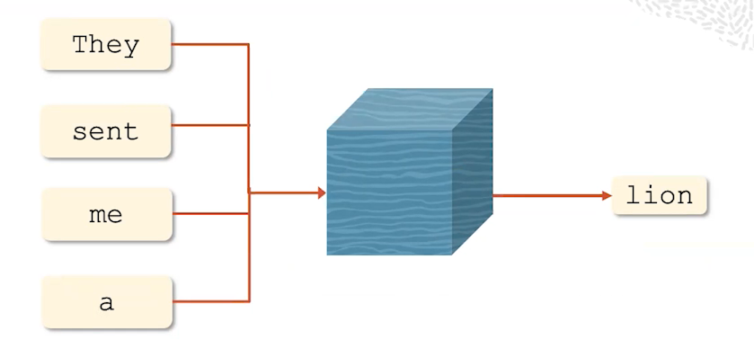
LLM Architecture
Decoder
Models that take a sequence of words and output next word. (Based on probability).

Slide 11
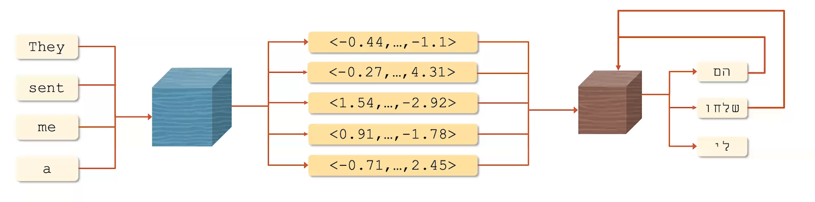
LLM Architecture
Encoder-decoder
Encodes a sequence of words and use the encoding to output the next word

Slide 12
Prompt & Prompt Engineering
Prompt
Prompt Engineering
The input or initial text provided to the model
The process of iteratively refining a prompt for the purpose of eliciting a particular style of response

Slide 13
Basic prompt techniques
In-context learning: Conditioning an LLm with instructions and or demonstrations of the task it is meant to complete
Summarize this text. Write it as a 3-bullet point summary. Make each sentence short and specific.
Use few-shot prompting and experiment with the number of examples
[sentence] This is great! //[sentiment] Positive
[sentence] This is really bad! //[sentiment] Negative
[sentence] That book was fantastic. //[sentiment] Positive
[sentence] That show was horrible! //[sentiment]

Slide 14
Basic prompt techniques
Chain-of-Thought: prompt the llm to emit intermediate reasoning steps .
Solve this problem step by step: If a car travels 60 miles in 2 hours, what is its speed? Here’s how you solve it:
Identify the formula for speed: Speed = Distance ÷ Time.
Plug in the values: Distance = 60 miles, Time = 2 hours.
Perform the calculation: Speed = 60 ÷ 2 = 30 mph.
Now solve this: If a car travels 120 miles in 3 hours, what is its speed?
The model will mimic your structured reasoning.

Slide 15








LLM providers

Slide 16
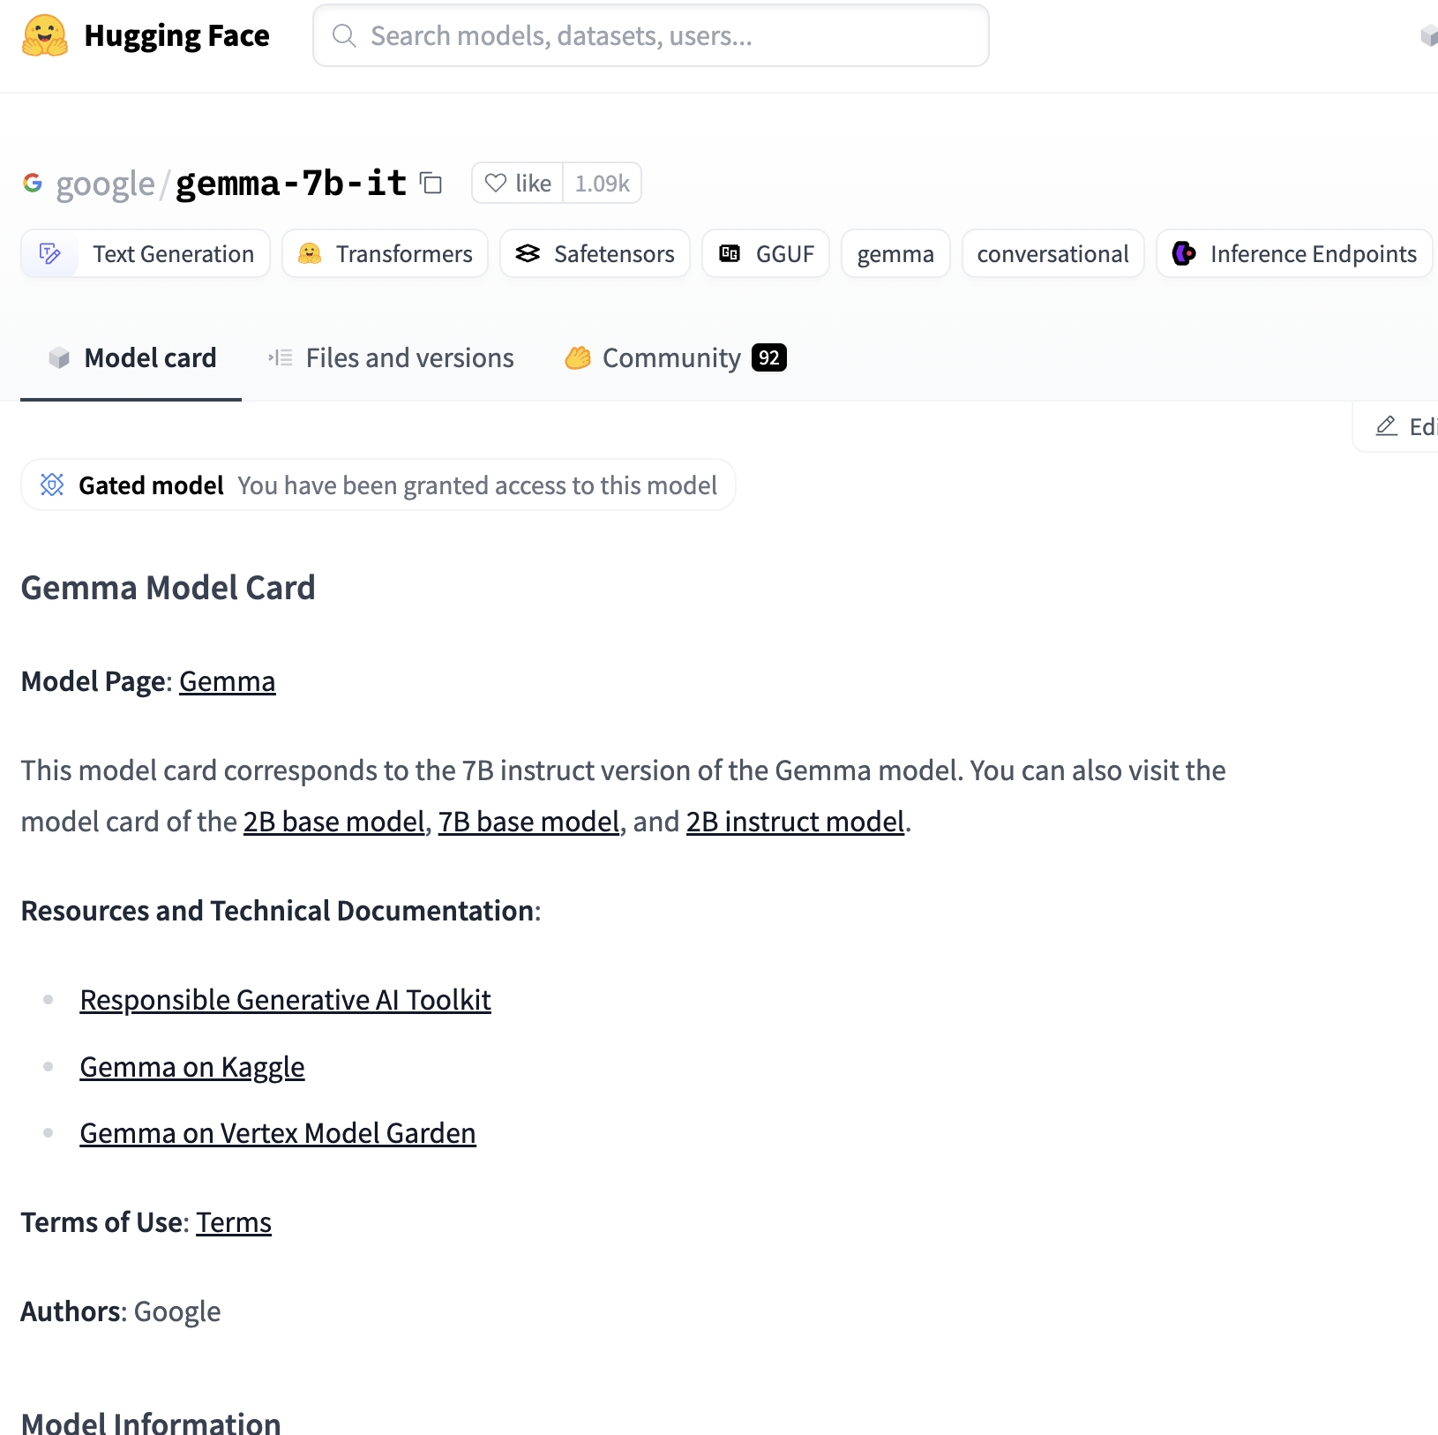
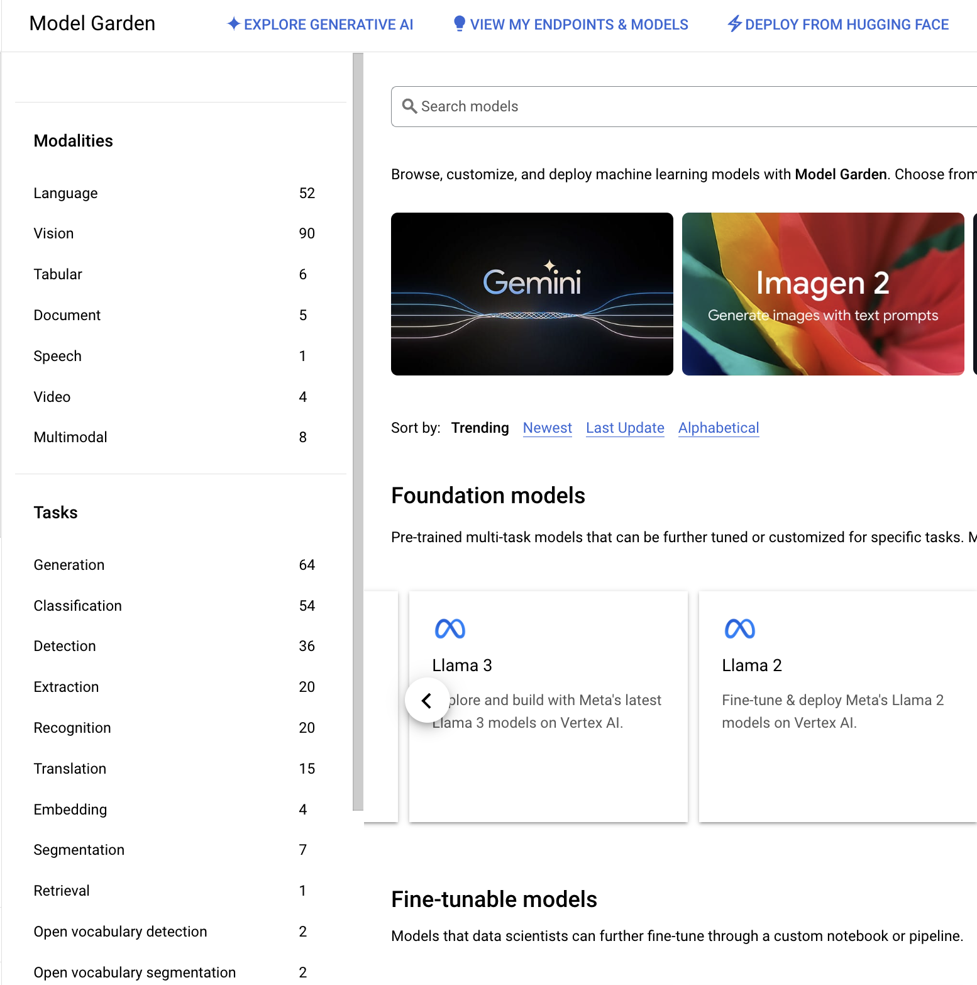
Places to Start Experimentation
Hugging Face
Vertex AI :Model Garden
Notes:
Vertex AI provides the infrastructure to train, fine-tune, deploy, and manage ML models,
while Model Garden gives you access to advanced pretrained models to use within Vertex AI or standalone.

Slide 17
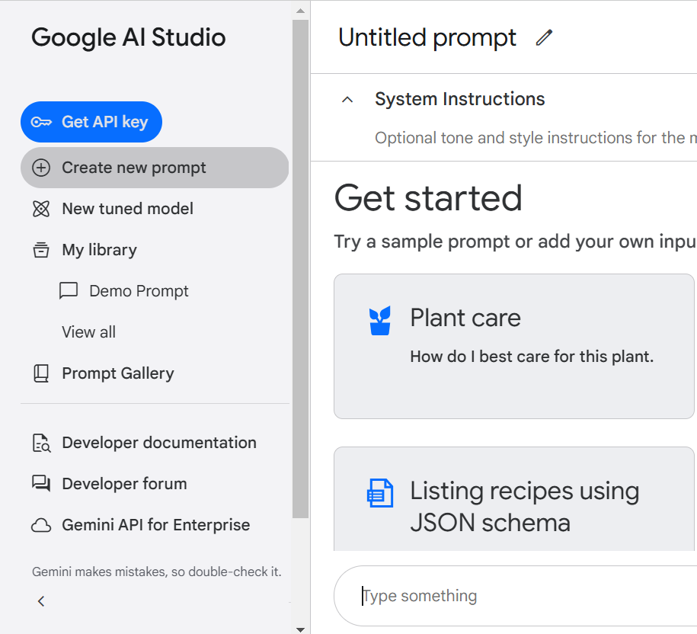
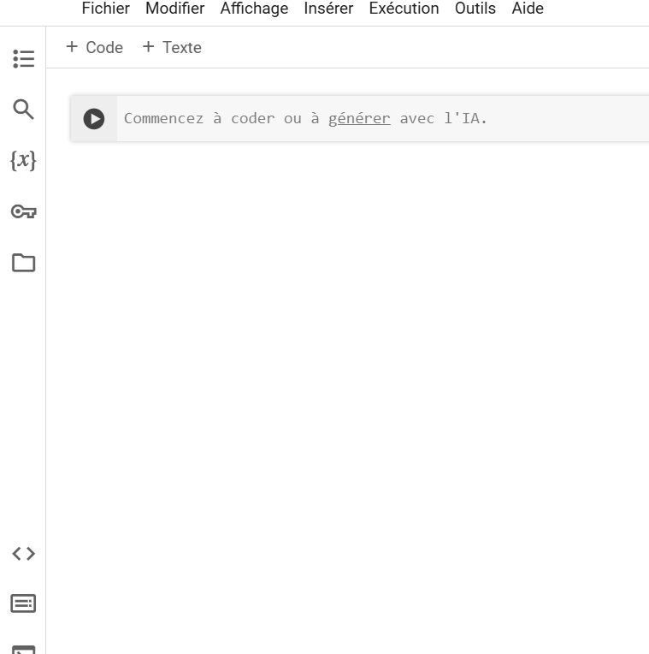
Places to Start Experimentation
Google AI Studio
Google Colab

Slide 18
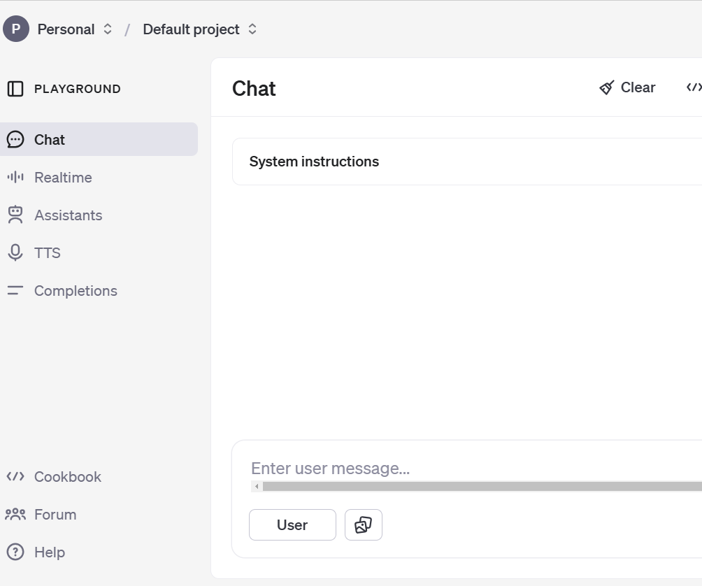
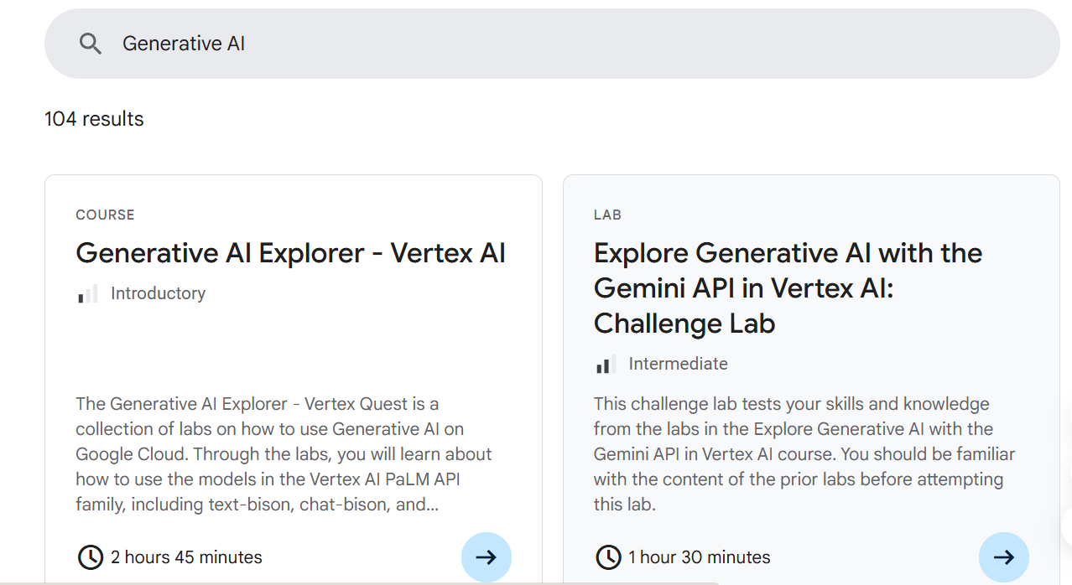
Places to Start Experimentation
OpenAI Platform
Google Cloud skills Boost

Slide 19
03
How to customize the LLM ?
Notes:
Let’s start with some useful context on Generative AI and Large Language Models, also known as LLM

Slide 20
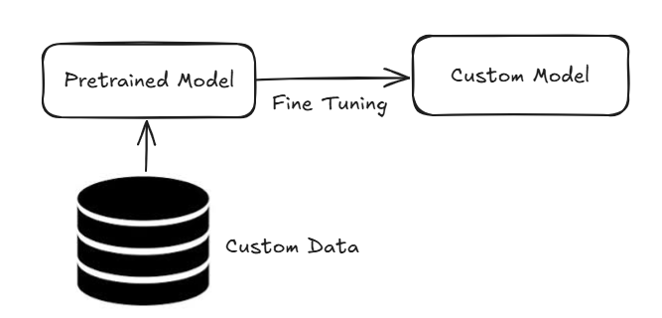
What is RAG?
Retrieval Augmented Generation
It's an advanced technique
used in LLMs.
The model retrieves
relevant information from
a knowledge base or
external sources.

Slide 21
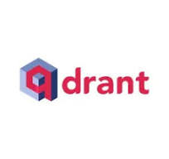


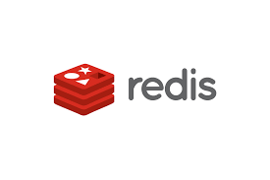




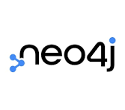
Vector Databases

Slide 22
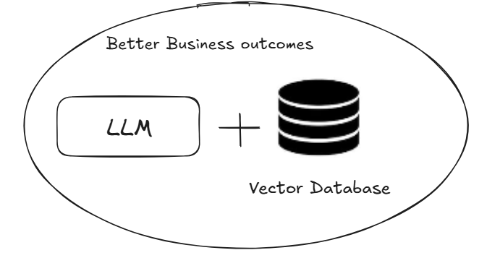
Role of Vector Databases with LLms
Cheaper than fine-tuning LLMs which can be expensive to update
Real-time updated knowledge base
Cach previous LLM prompts/responses to improve performance .

Slide 23
RAG Pipeline
1
2
3
Ingestion
Retrieval
Generation
This is the process of bringing external data into the system
Retrieve relevant data from the indexed sources to provide context for the model’s response.
Use the retrieved context to generate an accurate, relevant response.

Slide 24
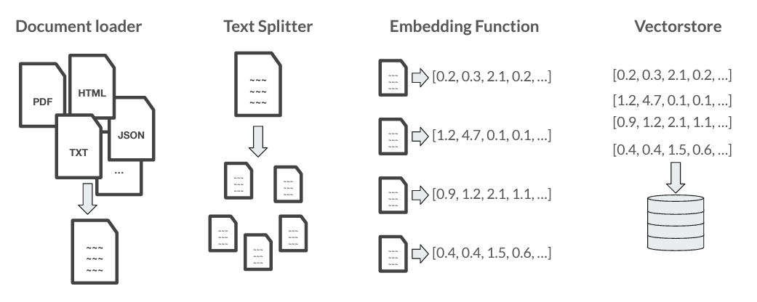
Ingestion

Slide 25
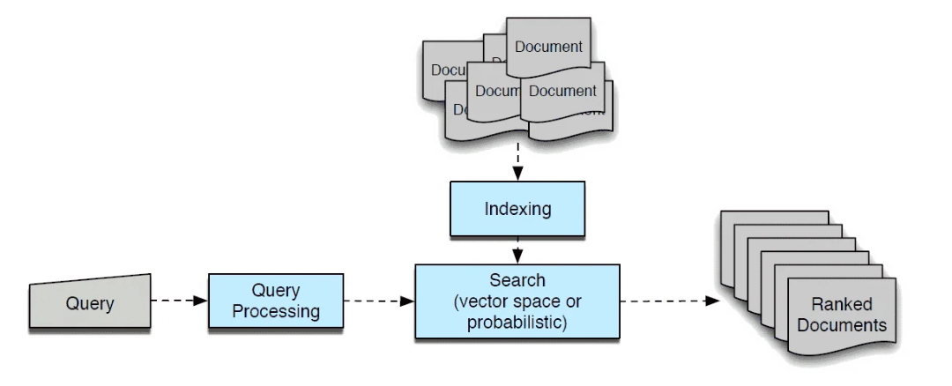
Retrieval

Slide 26
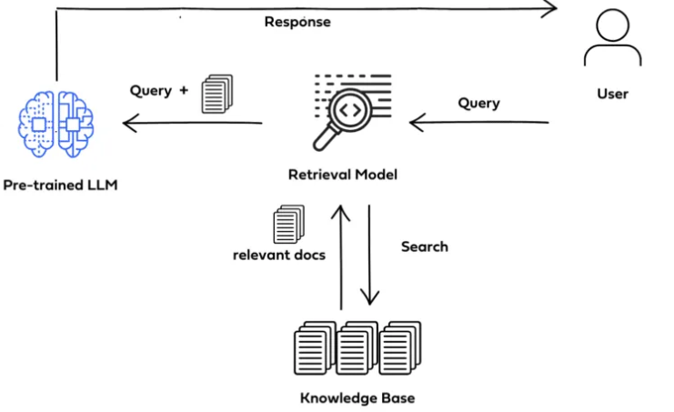
Generation

Slide 27
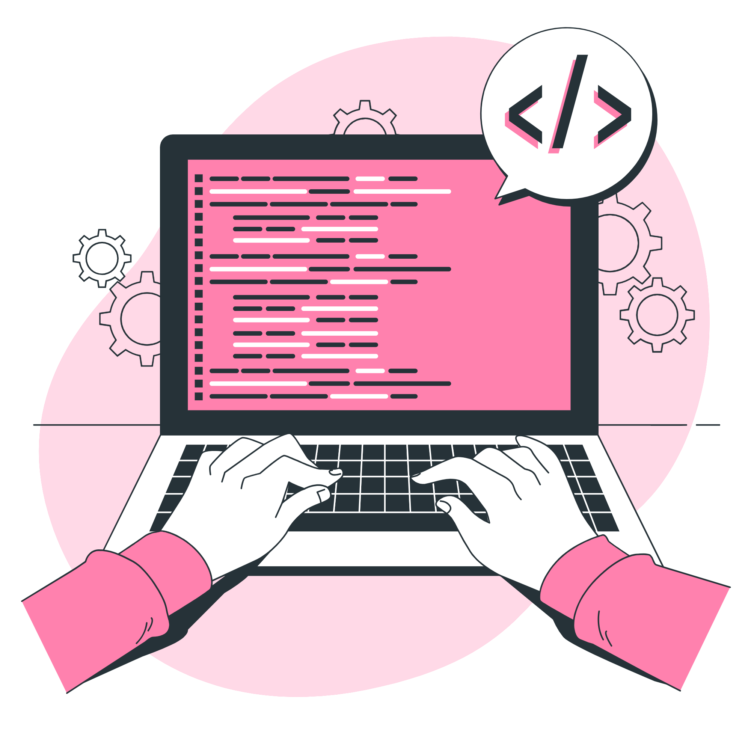
Let's practice
Notes:
intro / socials slide

Slide 28

Q&A
Notes:
Let’s start with some useful context on Generative AI and Large Language Models, also known as LLM

Slide 29

Notes:
intro / socials slide

Slide 30
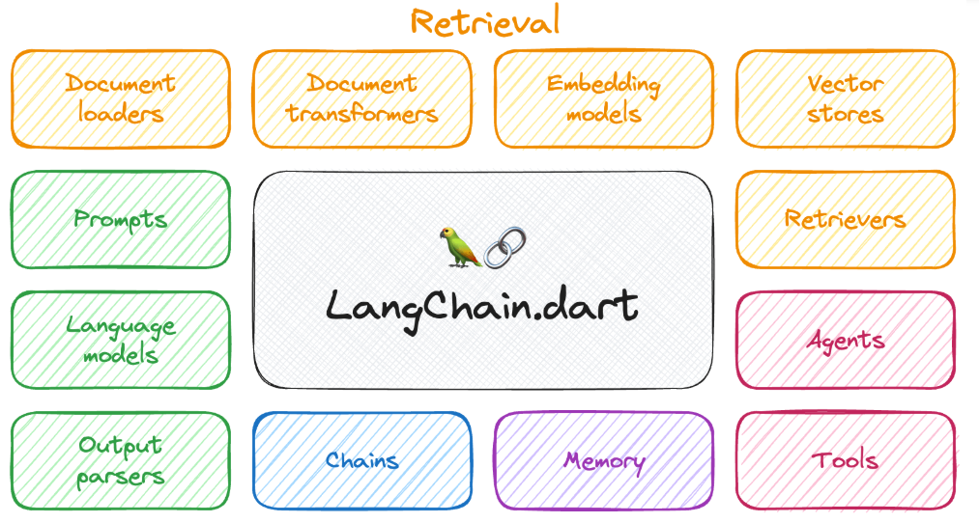
What is Langchain?
LangChain is a framework for
developing applications
powered by language models.
It offers a multitude of
components that help us
build LLM-powered
applications.

Slide 31
Memory
Agents
Retaining the entire conversation(store information about past interactions).
Use a given language model as a reasoning engine to determine which actions to take .
Language agents
Output Parsers
Are AI models designed to understand, generate, and manipulate human language. They are trained on vast amounts of text data to predict and generate the next word .
Interpreting or analyzing the model's output in a structured manner.

Slide 32
04
Let's practice
Notes:
Let’s start with some useful context on Generative AI and Large Language Models, also known as LLM

Slide 33
Learning rag from scratch
ai.google.dev/
github.com/GoogleCloudPlatform/generative-ai/tree/main/gemini/
cloud.google.com/vertex-ai/docs/generative-ai/tutorials
Vertex Model Garden
Hugging Face
Model Garden Community Repo
Explore Models in Model Garden
Resources
Notes:
Before diving into Q&A, we wanted to share a few additional resources - so if you have any questions we’re not able to get to today, then we encourage you to search for or create a new post in the Google Cloud Community and someone from the team or Community will be happy to help.
We’d also love to hear your feedback on this session or if you have any suggestions for future topics by completing our feedback form.
Lastly, we have a few additional events coming up that you can see here and you can sign up at that third link.

Slide 34


Slide 35
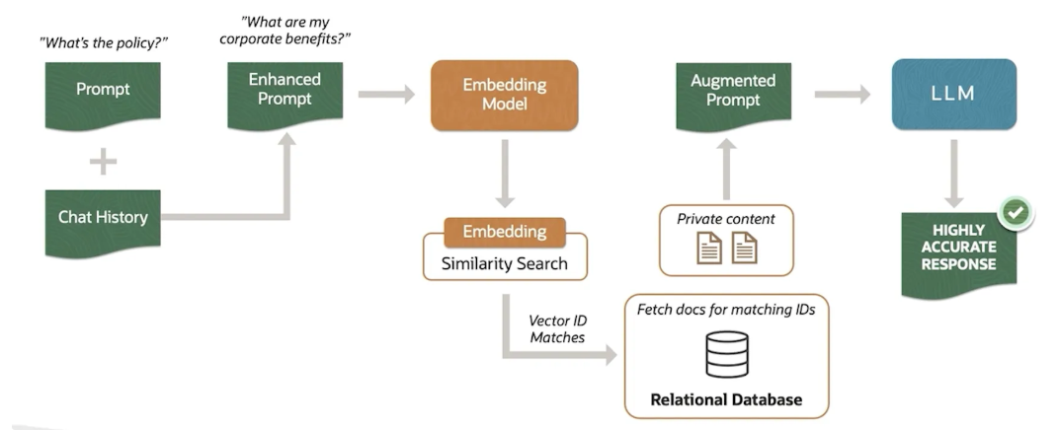
Conversational chatbot architecture

Slide 36
Transformational Moments
2014
Google started working on ML Fairness
2017
Google is an AI-first company
2021
LaMDA chatbot paper published
2022
Transformer- based models published: PaLM, PaLM2, Imagen, Parti, Phenaki
2022
Stable diffusion announced, downloadable
2023
Google Research and Google DeepMind solidify large model efforts in Gemini program for a world class multimodal model (Dec)
2017
Google publishes Transformer paper
2018
Google AI Principles published
2022
Google AI Test Kitchen announces guardrailed LaMDA
2022
ChatGPT announced, available to public (Nov)
2023
Bard Announced (Feb)
2023
Developer access, Cloud access via API at I/O 2023
Large, pre-Transformer models (e.g., MUM) applied to many products (e.g., Google Search, Translate, Maps)
Notes:
2014: Google started working on Machine Learning Fairness
2017: Google published the Transformer paper (foundation for modern language models) - Attention is All you need
2017: Reoriented to be an “AI-first company.”
2018: Google AI Principles published
2017 - 2021: Large pre-transformer models, e.g., MUM, applied to many products, e.g., Google Search, Translate, Maps…
2021: LaMDA chatbot paper published
2022: Research works on and publishes large transformer-based language models (PaLM, PaLM 2) and multimodal models (Imagen, Parti, Phenaki)
August 2022: Google AI Test Kitchen announced for guardrailed use of LaMDA
August 2022: Stable Diffusion announced, and is downloadable
November 2022: Chat GPT announced, and is made accessible to the public
December 2022: Google Research+ DeepMind solidify large model efforts in the Gemini program for a world class multimodal model
Feb 6, 2023 - Bard announced
May 2023 (I/O): Developer access and Cloud access via API

Slide 37
Two important choices
Proprietary + Confidential
What Model?
What Infrastructure?
🤔

Slide 38
Finding the right open model
Modality | Size | Use Case
Are you working with text? Code? Image? Video? What languages will you be prompting the model with? | Is your use case real time? Or can you cache results after processing in batch? | Do you need a model with advanced reasoning capabilities (good at Chain-of-Thought, etc)? Or is your task more straightforward (summarization, basic Q&A)

Slide 39
Finding the right infrastructure
Throughput | Latency | Size & Budget
What volume does your use case need to support? How many users on your application concurrently? | How fast does model inference need to be? Is your use case real time (chat bot, agent, etc) | How big is your model? Generally, small models (< 10B parameters) can run on an L4 GPU ($) while larger models might need an A100 or TPUs ($$$)

Slide 40




Vertex AI is built for developers
Interfaces for
all developers
Extensive quick start library with code samples and jumpstarts for developers of all levels and ecosystems
Vertex AI
Colab
Free developer labs and training resources across Vertex products at Cloud Skills Boost
Robust integrations with popular third party developer tools like Lang Chain, LlamaIndex, Pinecone, and Weaviate.
Packages and extensions to natively support Google Cloud foundation models in Google app developer frameworks like Firebase and Flutter.
Flutter
Firebase
Notes:
In addition to Google AI Studio and Vertex, we’ve integrated our AI models // including Gemini into popular platforms like Colab Enterprise, Firebase, and Flutter.
With these integrations, any developer can be an AI developer.

Slide 41

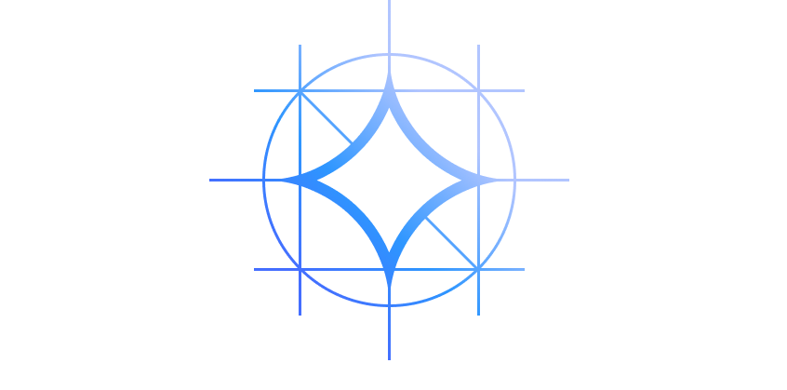

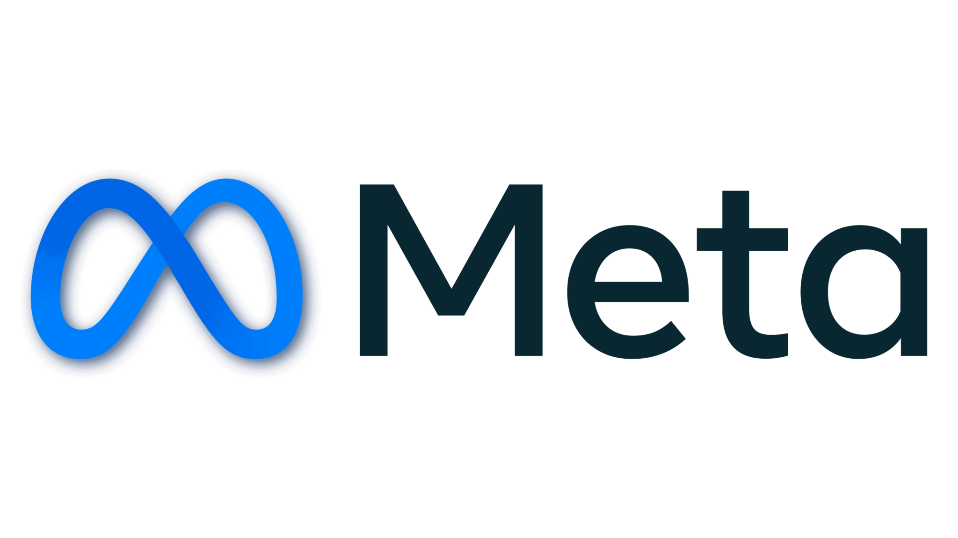


Google’s Foundation Models on Vertex AI
Across a variety of model sizes to address use cases
GA
NEW
Limited Private GA
NEW
Gemini 1.0 Pro
Multimodal reasoning across a wide range of tasks
Gemini 1.5 Pro
Multimodal reasoning for longer prompts, 1 million context window
Gemini 1.0 Ultra
Largest and most capable model for highly complex tasks
Gemma 2B and 7B
Family of lightweight, state-of-the-art open models
PaLM for Text / Chat
Custom language tasks and multi-turn conversations
Imagen 2.0 for Text to Image
Create and edit images from simple prompts
Chirp for Speech to Text
Build voice enabled applications
Codey for Code Generation
Improve coding and debugging
NEW
NEW
Embeddings API for Text and Image
Extract semantic information from unstructured data
Open Models on Vertex AI
Mixtral 8x7B, Image Bind, DITO and more
Hugging Face Models
Few click deployment to Vertex AI
Claude on Vertex AI
Claude 2, Instant 1.2, and more

